Slide 1




Students prformance
AI and Machine Learning

Slide 2
Introduction
Student Performance Dataset (Portugal – Math & Portuguese)
Source: Data collected from two Portuguese secondary schools.
Subjects: Mathematics and Portuguese language.
Goal: Predict students’ final grade (G3) based on personal, social, and academic features.
Features (Inputs)
Demographics:
Age, Gender, Address (urban/rural), Family size, Parents’ education & jobs.
Social factors:
Family relationships, Free time, Going out, Romantic relationship, Alcohol consumption.
Academic factors:
Past grades (G1, G2), Study time, School support, Extra classes, Absences.
Target:
Final grade (G3) in Math or Portuguese.

Slide 3

steps i do
Define the Problem
Predict student performance (risk level or grade category)
Preprocessing
Handle missing values.
Encode categorical variables (gender, address, reason).
Create engineered features ( average of G1, G2, G3).
Perform feature selection to keep the most important ones.
Model Training
Train multiple ML models (Logistic Regression, SVM, Random Forest, etc.).
Evaluate performance using accuracy, precision, recall, and F1-score
Hyperparameter Tuning
Optimize the best-performing model (Logistic Regression in your case).
Select the final model for deployment.
Optional Advanced Experiments
Try Deep Learning (Neural Networks).
Use NLP ( BERT sentiment analysis on “reason” feature).
Model Evaluation
Generate classification reports and confusion matrix.
Compare traditional ML vs Deep Learning results.

Slide 4
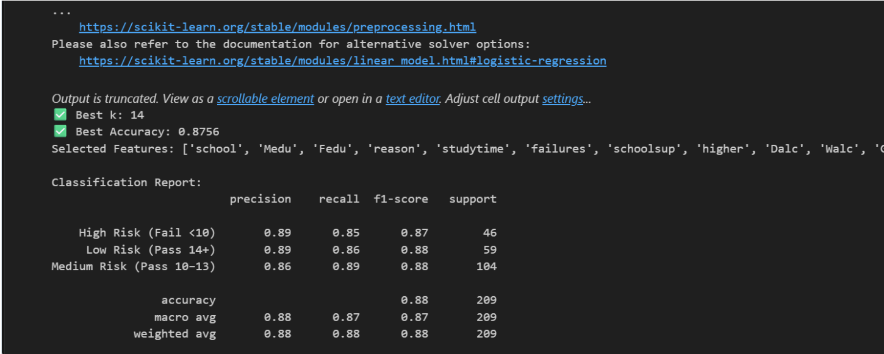
Best Model

Slide 5
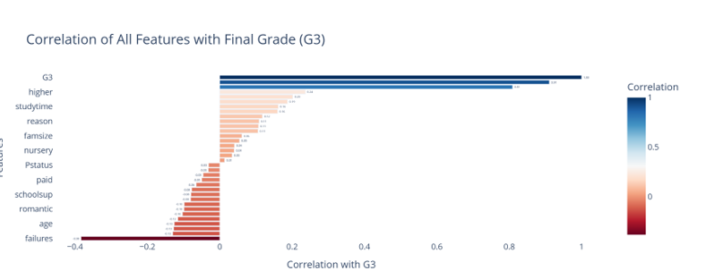
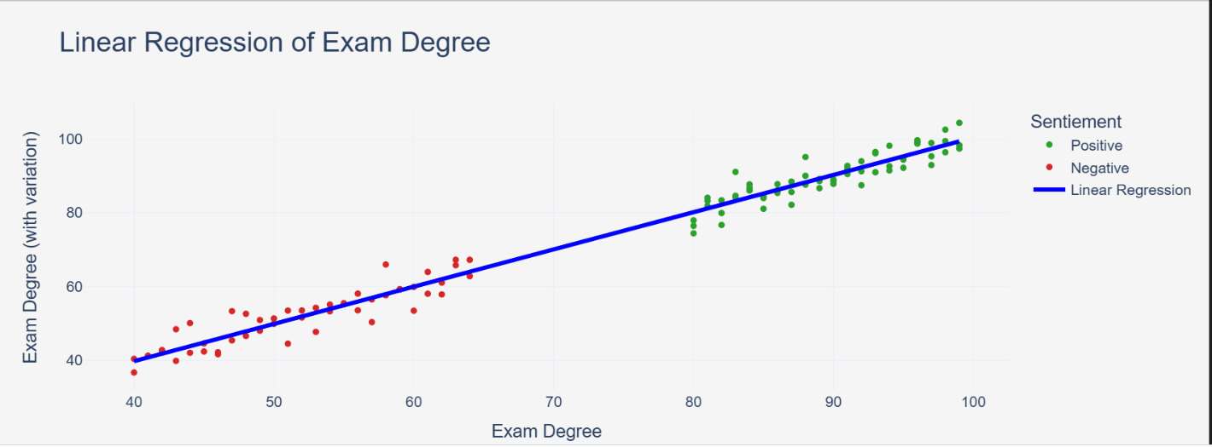
relation between sentiement and score

Slide 6
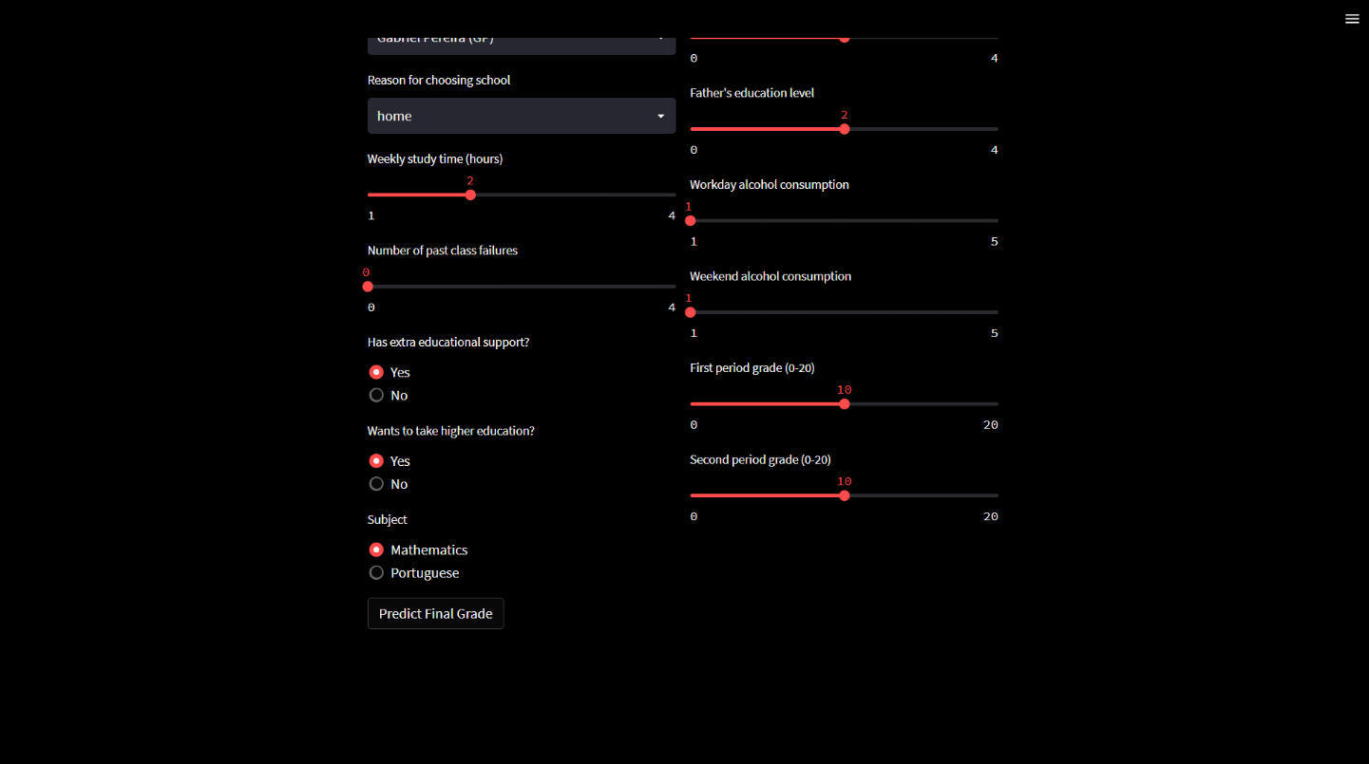
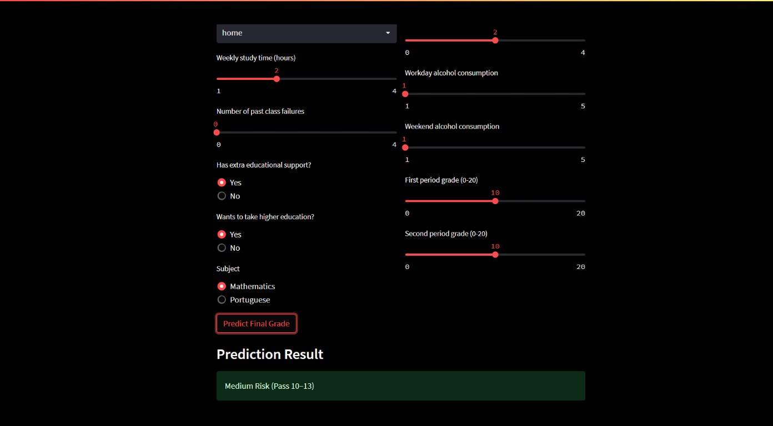
Applications of
AI and Machine
Learning

Slide 7
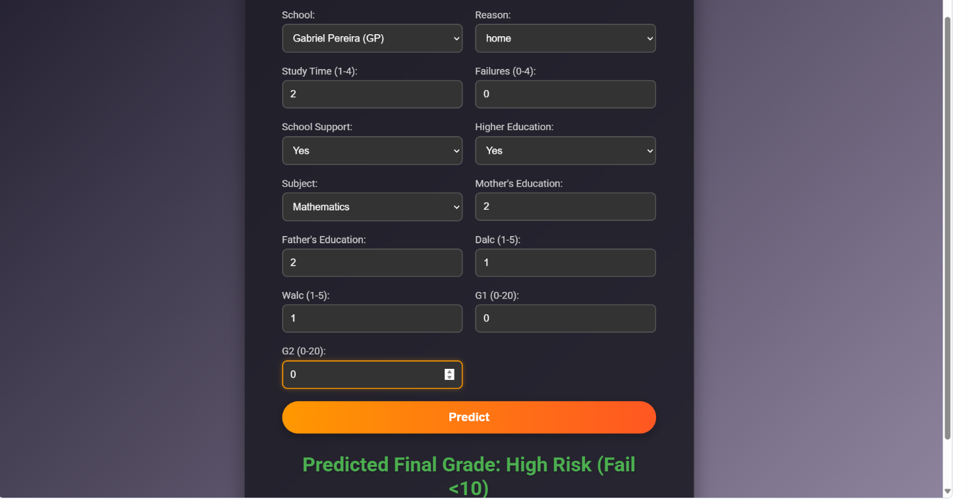
Applications of
AI and Machine
Learning (Flask)

